Slide 1


Movie Profit and Score Prediction
Team 27:
Sabrina Chen
Demir Degirmenci
Lizzie Wang
Parin Vora

Slide 2

01
Business/ data Understanding

Slide 3

Business Problem
Producers face critical decisions in casting, budgeting, and marketing during film production.
Without data-driven insights, these choices can lead to failure, risking large investments and potential future films.
A reliable prediction model is needed to guide informed decisions, maximizing profit and audience ratings.
Business/ data Understanding
Modeling Approach
Evaluation
Deployment

Slide 4
Business Goal
Provide actionable insights using data mining to make informed decisions about casting, directors, and production choices.
Maximizing Profit and Enhancing Movie Ratings
Business/ data Understanding
Modeling Approach
Evaluation
Deployment

Slide 5
Data Overview
Dataset Includes:
Budget
Gross Revenue
Genre
Director
Star
Score
Votes
Company
Year
Potential biases
Rating Bias:
The majority of films are rated R and PG, with fewer instances of other ratings may skew predictions toward common ratings
Budget Discrepancies:
Big-budget blockbusters are overrepresented leading the model to perform better on high-budget films while underestimating profitability for low-budget films.
Categorical Variable Simplification:
To simplify the model, only the top 10 stars, directors, writers, and companies were retained, with all others grouped as "others." Could lead to less accurate predictions for films involving smaller companies, less famous stars and directors, limiting the model’s generalization for niche productions.
Business/ data Understanding
Modeling Approach
Evaluation
Deployment

Slide 6

02
Modeling Approach

Slide 7
Approach
Fold cross-validation
out-of-sample R²
select the best model
post-lasso
(linear regression model)
random forest
K-nearest neighbor
Features
Models
Prediction
Evaluation
Choose relevant features
Split training and testing dataset
Predict the profit and score for the movies in testing dataset.
Background Information
Current rating system
Framework for current system
Prediction models

Slide 8
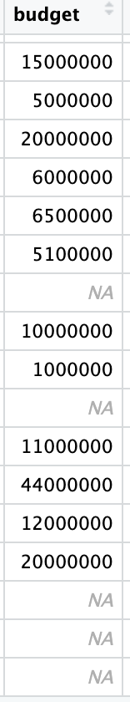
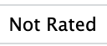
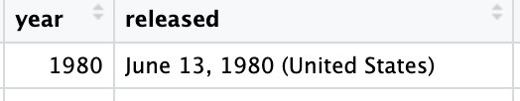
Data Preparation
Data Cleaning:
Dropped missing or useless values, unnecessary columns (e.g., name, release date).
Categorical variable handling: select top 10 and “others” (e.g., directors, companies).
New Columns:
Created a "Profit" column by subtracting budget from gross revenue.
Data Split:
80% training, 20% testing.
Business/ data Understanding
Modeling Approach
Evaluation
Deployment

Slide 9
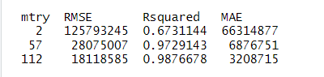
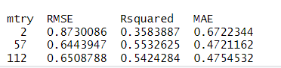
Random Forest Model
Metric | Value
MSE(profit) | 9.59e+13
RMSE(profit) | 9793608
MAE(profit) | 2462509
OOS R2 (profit) | 0.99618
MSE(score) | 0.41619
RMSE(score) | 0.64513
MAE(score) | 0.46308
OOS R2 (score) | 0.56093
Trained the Random Forest model using cross-validation.
For profit:
For score:
Predict
Business/ data Understanding
Modeling Approach
Evaluation
Deployment

Slide 10
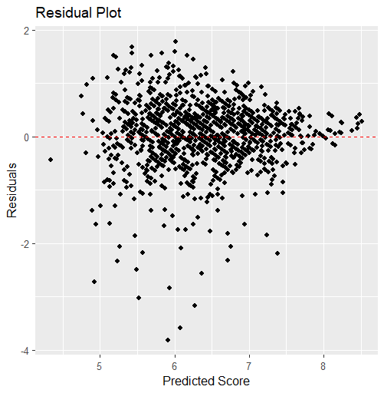
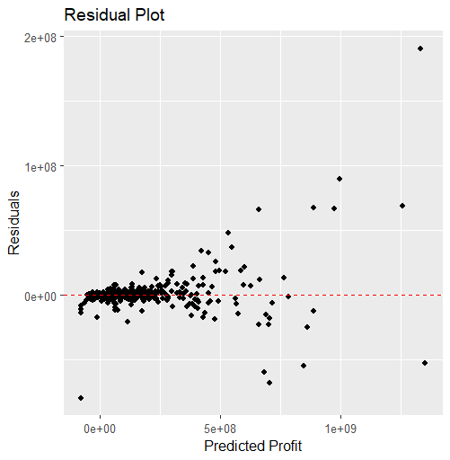
Random Forest Model
Business/ data Understanding
Modeling Approach
Evaluation
Deployment

Slide 11
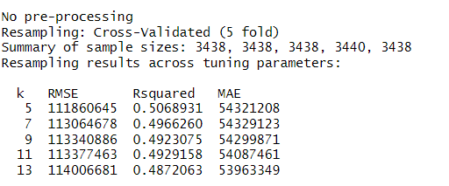
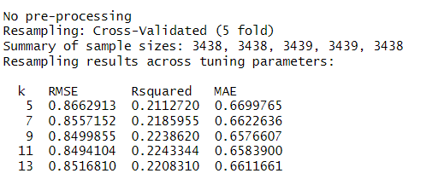
K-Nearest Neighbors (KNN) Model
KNN calculates the distance between a target movie and its neighbors using a distance metric
k=5 provided the best accuracy for profit predictions, while k=11 gave the best performance for IMDb score predictions.
Predict
Metric | Value
MSE(profit) | 1.49e+16
RMSE(profit) | 122068330
MAE(profit) | 61797564
OOS R2 (profit) | 0.4063
Metric | Value
MSE(score) | 0.7419
RMSE(score) | 0.8613
MAE(score) | 0.6648
OOS R2 (score) | 0.2172
Business/ data Understanding
Modeling Approach
Evaluation
Deployment

Slide 12
Post-Lasso with Linear Regression
Lasso Regression: Lasso was used to select the most important features
Lasso identified only the most significant features for profit and score prediction
Again, k-fold cross-validation was applied to ensure the generalizability of the model.
Metric | Value
MSE(profit) | 1.2e+16
RMSE(profit) | 109881293
MAE(profit) | 62264547
OOS R2 (profit) | 0.5189456
MSE(score) | 0.52599
RMSE(score) | 0.72525
MAE(score) | 0.53329
OOS R2 (score) | 0.44498
Predict
Business/ data Understanding
Modeling Approach
Evaluation
Deployment

Slide 13

03
Evaluation and Comparison

Slide 14
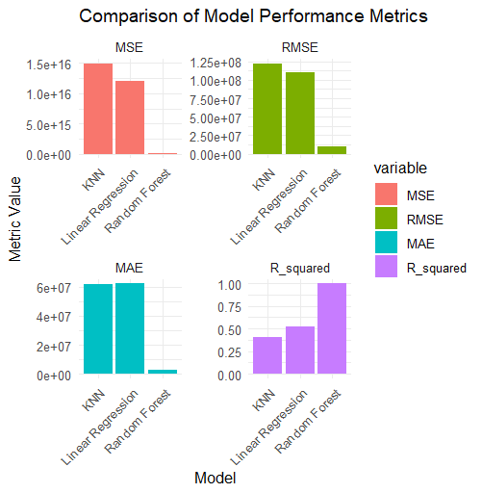
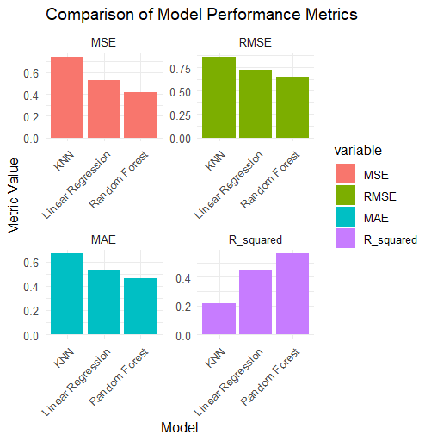
Comparison
Profit
Score
Business/ data Understanding
Modeling Approach
Evaluation
Deployment

Slide 15

Deployment
04

Slide 16
Best models-- Random Forest
Input Key Features for Decision-Making
Producers can input the key features (e.g., budget, genre, director, star, country) of a movie, the Random Forest model will predict the expected profit based on similar past movies.
If a producer wants to focus on higher-quality films with the potential for critical acclaim, the model’s score prediction can guide choices regarding directors, writers, or specific genres that tend to score higher with audiences.
Scenario Planning for Casting and Crew Selection
Producers can use the model to simulate different casting or crew options (For instance, if two stars are being considered, the model can predict the likely profit or IMDb score for each scenario based on historical data of those stars in similar roles.)
Genre and Audience Targeting
The Random Forest model can help producers or platforms determine which genres are more likely to generate higher profits or scores, especially in specific countries or regions.
Business/ data Understanding
Modeling Approach
Evaluation
Deployment

Slide 17

Thanks!

